Slide 1
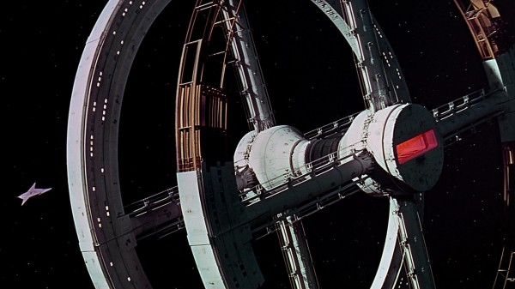
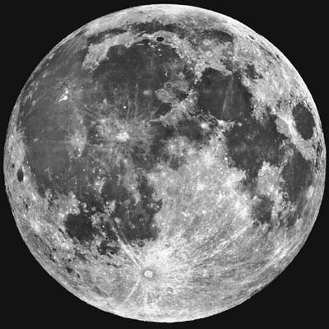
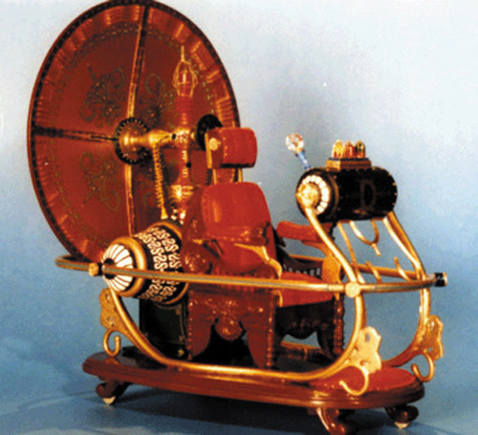
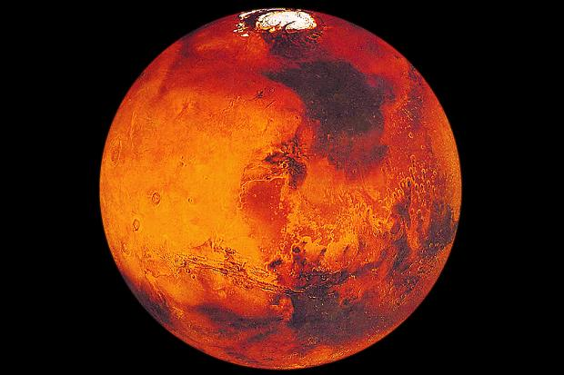

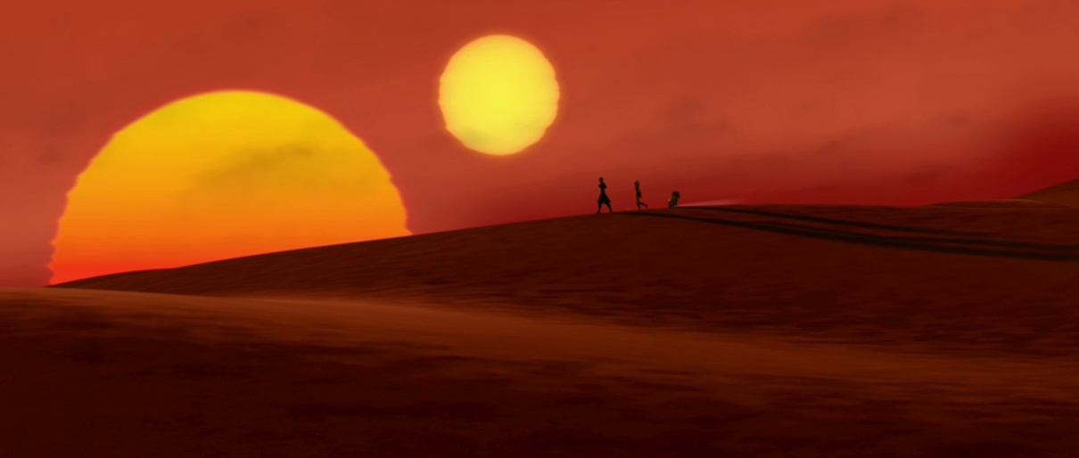
Worlds of Science and Imagination

Slide 2
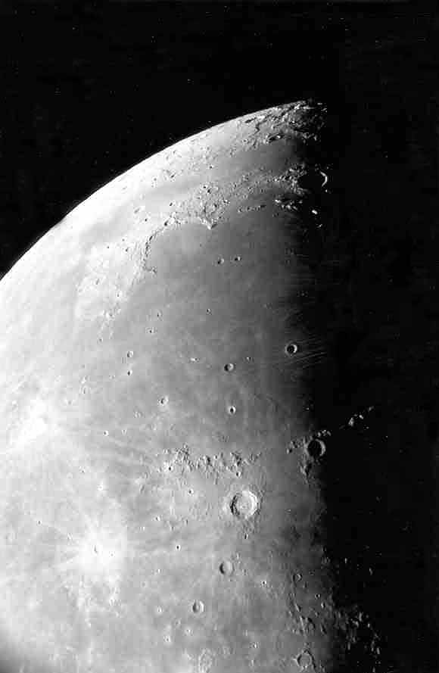
Moon maré as seen through the telescope.
Photo by Jim Fullerton

Slide 3
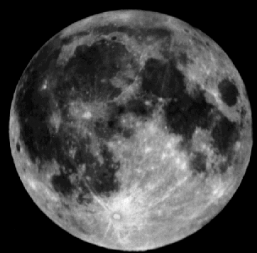
The maria (maré) are the smooth dark areas on the surface of the Moon.
maré
highlands

Slide 4



Stories of Moon exploration were highly popular during the 1950s and 60s (the Apollo era). Interest subsequently dropped off but reemerged again in the 1990s and continues through today.
1952
1955
1960

Slide 5

Robert Heinlein’s The Moon is a Harsh Mistress (1966) involves a war of independence by lunar colonists against corporate Earth.

Slide 6
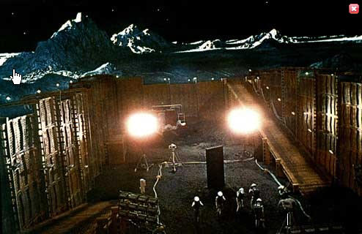
In 2001: A Space Odyssey, an extraterrestrial monolith was dug up on the Moon and began beaming an intense signal to its twin orbiting Jupiter.

Slide 7
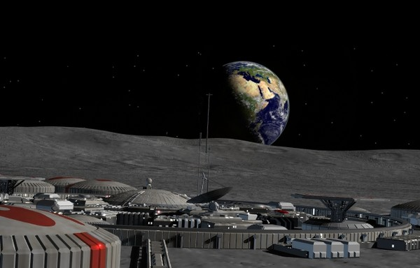
Moon bases have been a popular location for science fiction stories to take place. These bases have typically been for observation and defense outposts.

Slide 8
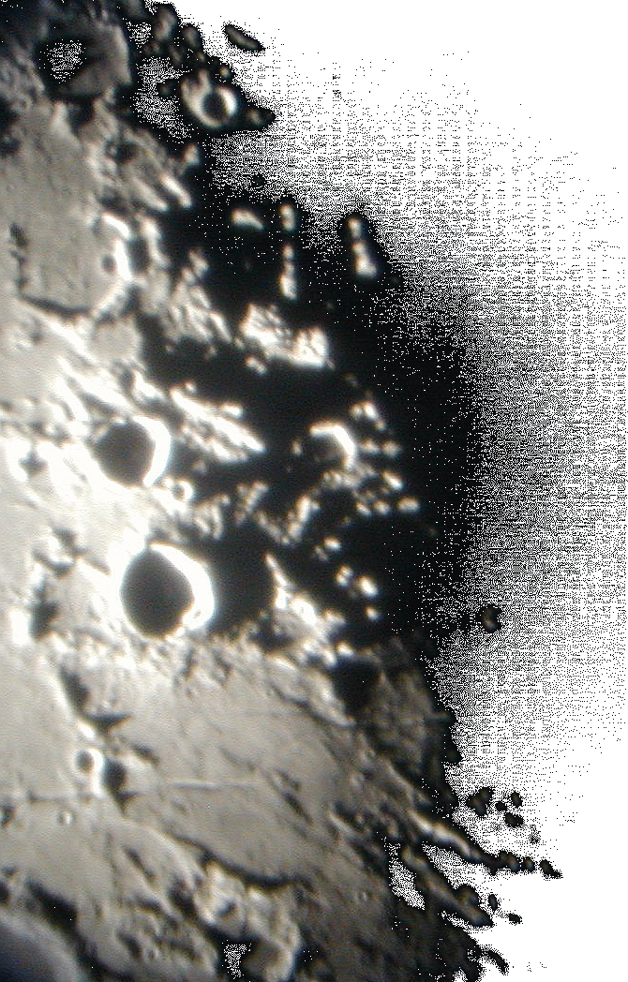
The Moon=s many craters and other features are best seen near the terminator - the line between day and night.
Photo by Lake Afton Public Observatory

Slide 9
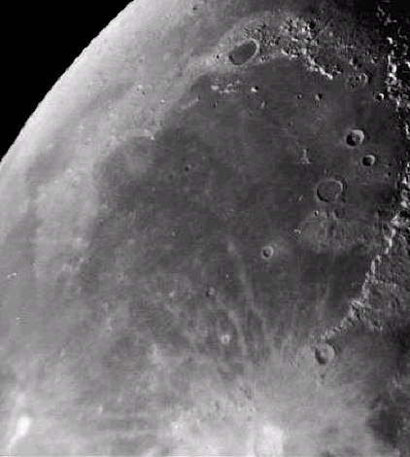
This photo shows a smooth floored lunar maré. You can easily recognize the ancient rim of the original impact basin now a mountain range .
Mare Imbrium

Slide 10
The maré were formed about 3.5 – 4 billion years ago.
Lava flowed through cracks in the lunar surface and filled in low laying areas.
Mare Imbrium

Slide 11
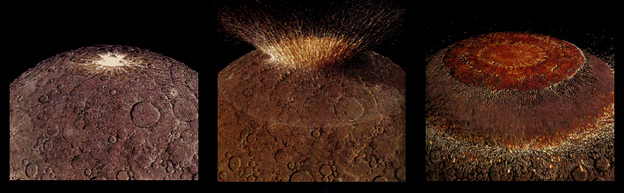
Four billion years ago the impact from a large asteroid formed a huge multi-ringed basin which then thinned and fractured the lunar crust.

Slide 12
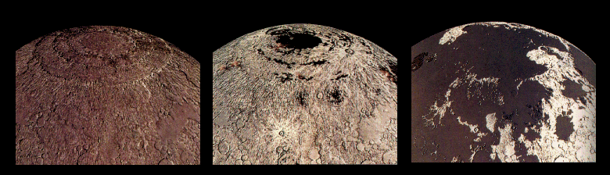
Fluid lavas from beneath the moon’s crust flowed out and flooded the low regions of the lunar surface – covering up many craters.

Slide 13
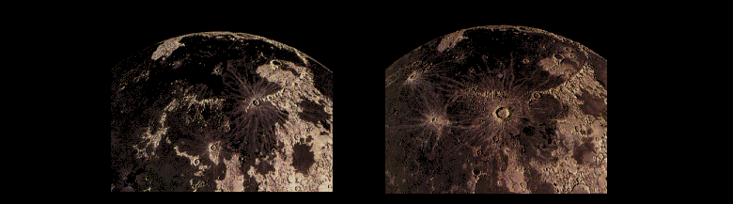
Less than a billion years after they began, the lavas ceased flowing out onto the Moons surface. However, occasionally new craters were created on top of these ancient flows.

Slide 14
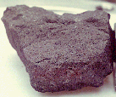
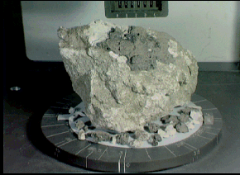
Lunar rock samples from the moon’s maré are dark colored rocks.
Samples from the highland regions are much lighter in color.

Slide 15
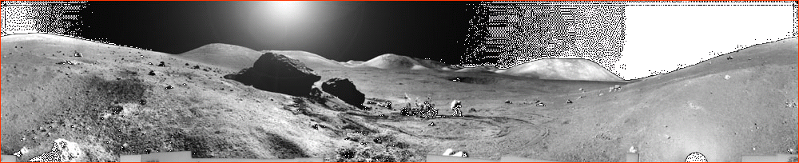
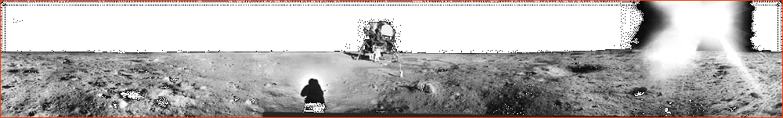
One of these shows the lunar surface from a maré and the other the highlands.
Can you tell which is which?

Slide 16
The highlands are rugged.
The maré are smooth & flat.

